Slide 1
Presentation template:
Please read before proceeding.
Statements starting with ‘//’ are comments. Do not include it in your presentation.
The font style is fixed as Times new roman in the whole presentation.
The template shows single slides for each sections like introduction, literature survey etc.
But you can put any number of slides in order to elaborate a particular section.
Your presentation can contain any bar graphs, pie charts, smart art graphics etc.
The next slide in this template will be your first slide. Do not change the order
of the slides. Best of luck.

Slide 2

Bachelor Of Technology
Computer Science and Engineering (Data Science)
311 Program in collaboration with Virginia Tech. USA
Mini-Project Presentation
SVKM’s NMIMS
Mukesh Patel School of Technology Management and Engineering, JVPD, Vile Parle, West
Mumbai- 400056

Slide 3

A PRESENTATION ON
“Optimizing Advertisement cost”
By
Anrunya Patole
Kshama Purohit
Archita rai
Faculty Mentors:
Prof. Ami Munshi, Prof. Mahesh Mali and Prof. Khinal Parmar

Slide 4
Contents
Introduction
Literature Survey
Problem Statement
System Description
Implementation
Result and Analysis
Conclusion
Future Scope
References

Slide 5
Introduction
This combined mini project is an accumulation of a business statistics concept , analyzed using python and visualize using SAS. The idea behind this assignment was to create a functioning model for optimizing the cost incurred by companies with regards to advertisement , using Facebooks geographically targeted sample data.

Slide 6
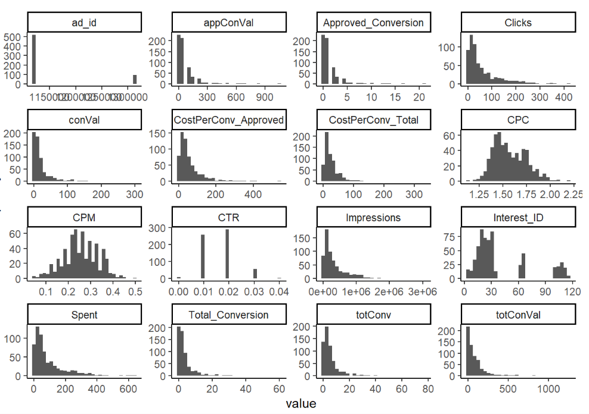
Literature Survey- Other works
1] Marketing Analysis using R
By Nicolas Kaswalder
May 13th, 2020
This project focuses on analyzing the data from business perspective the different campaigns and ads that were created in Facebook and their specific targets that give answers towards the success of the different ads generated by using various statistical methods.
Figure 1 Sample from survey

Slide 7
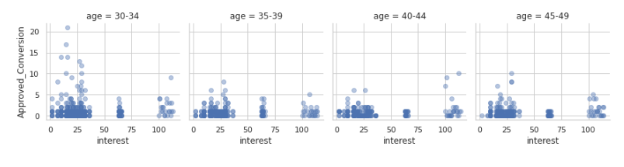
2] Facebook Ad-Campaigns Analysis
By MANSI MEENA
2 years ago
This project focuses on exploring Data Analysis using matplotlib and seaborn and model training using Random Forest Regressor
Figure 2 Sample from ad campaign analysis

Slide 8
Literature Survey-Comparison
Our work is different from the previously mentioned analysis cause of the following points listed below:
Our project involves sampling while there was pure data analysis.
Our project had linear programming in order to optimize the sales.
Our aim was different as we planned to find an optimal solution through sampling for a levelled comparison to determine the optimum investment solution instead of the already existing data.

Slide 9
Problem Statement
The BOD meeting of Facebook reaped that the directors are not happy with the number of returns they're receiving based off all the advertisement campaigns. Our job as data analysts is to collect , analyze , optimize and then visualize the data so as to make sure that the company is able to minimize its costs from the advertisements.

Slide 10
System Description
// Hardware & Software Requirements
// Block Diagram
// Flow Chart

Slide 11
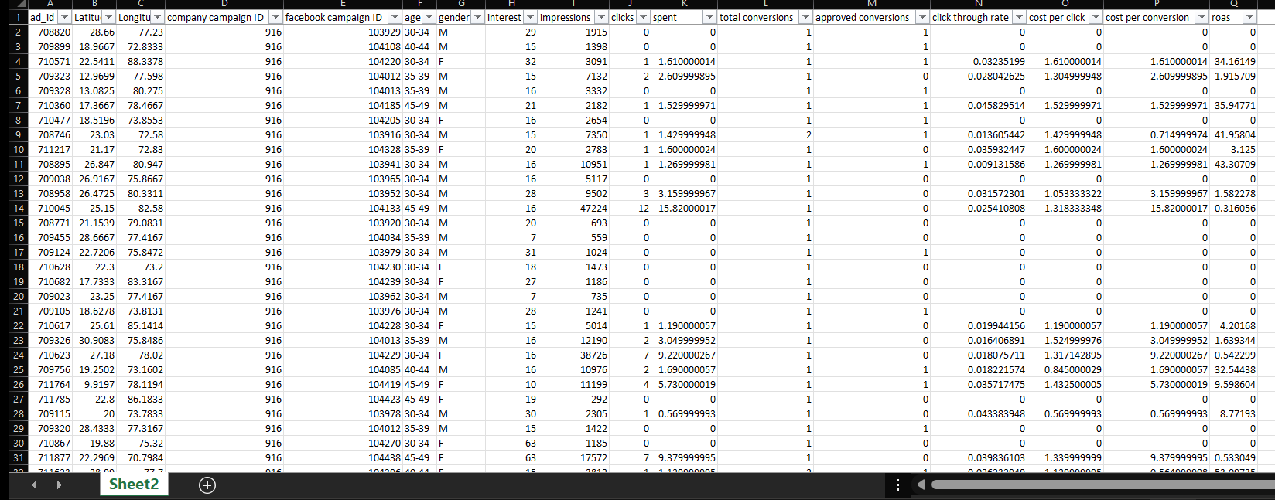
Implementation-Data
Figure 3 sampled and cleaned data

Slide 12
Implementation-Coding
Various libraries such as Matplotlib, pandas , seaborn , pULp were used in the analysis of this data through python.
Using python we found the optimal solution for the provided input by the user.
Python was also used to clean and profile the data

Slide 13
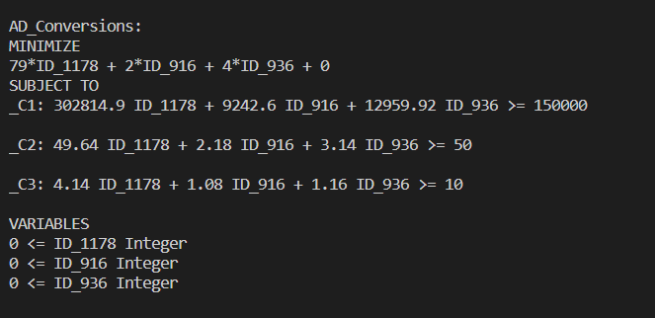
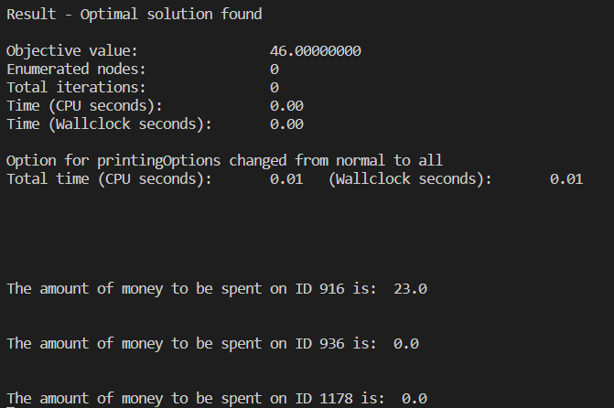
Implementation-Coding(output)
Figure 4,5,6 coding input and outputs

Slide 14
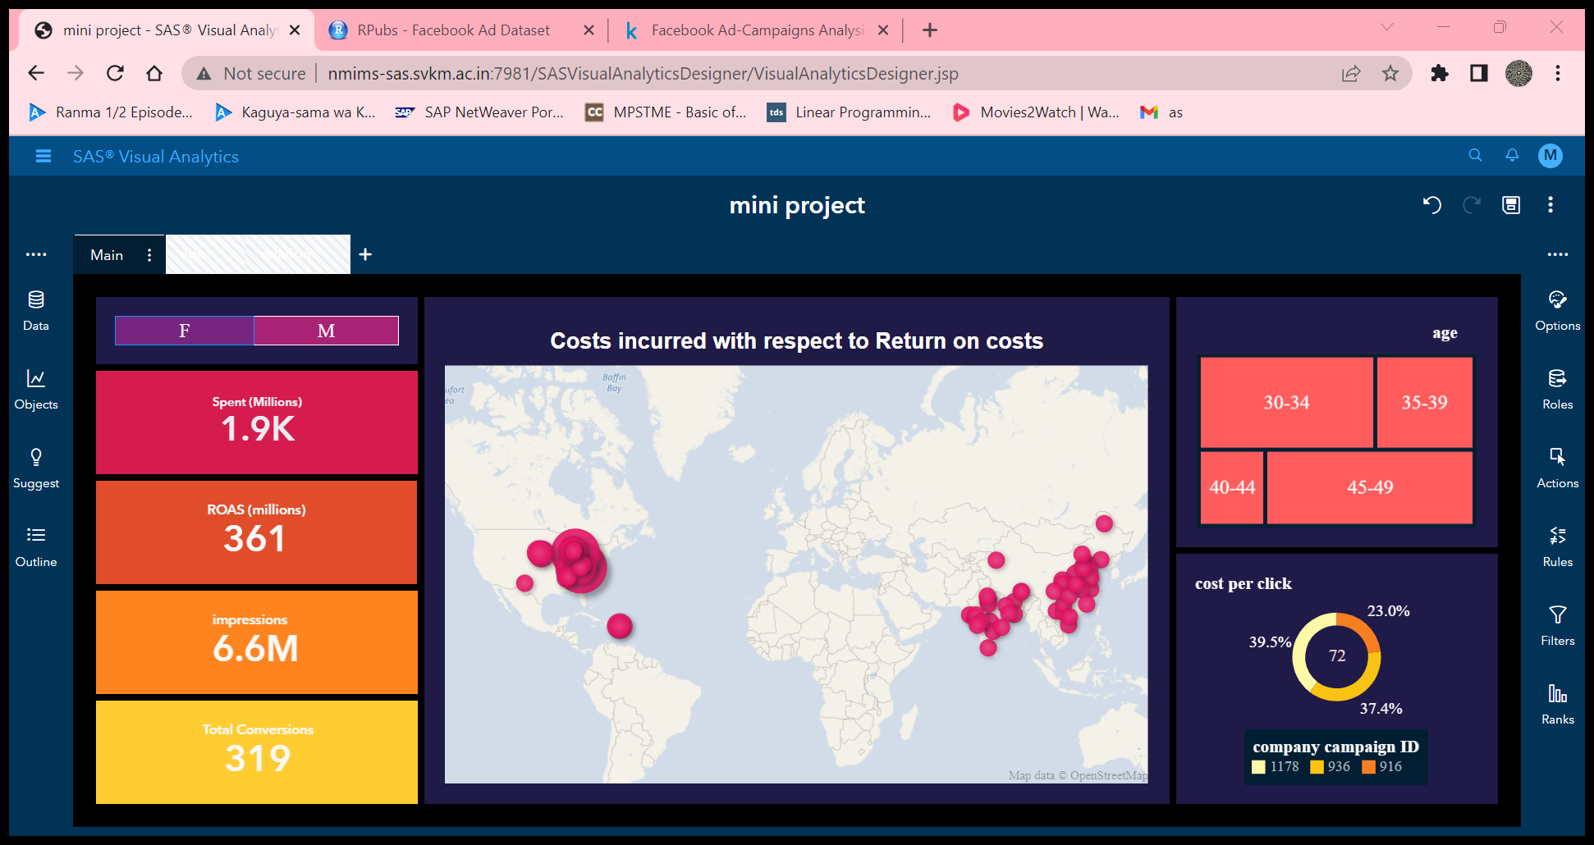
Implementation-Dashboard
Figure 7 dashboard main UI

Slide 15
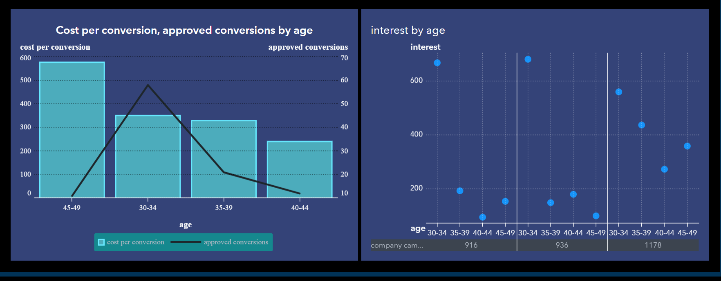
Figure 8 Dashboard linked page age

Slide 16
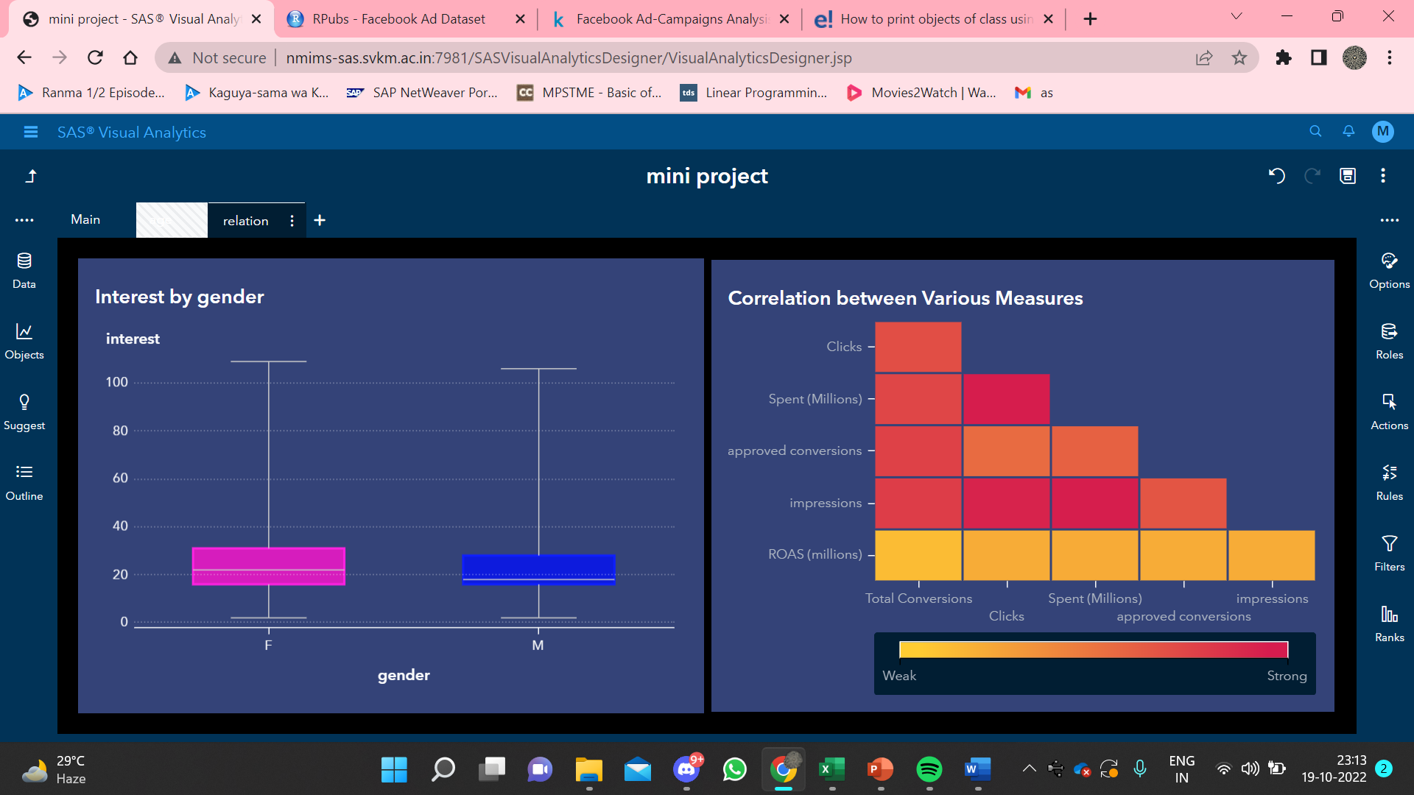
Figure 9 Dashboard linked page pie chart

Slide 17
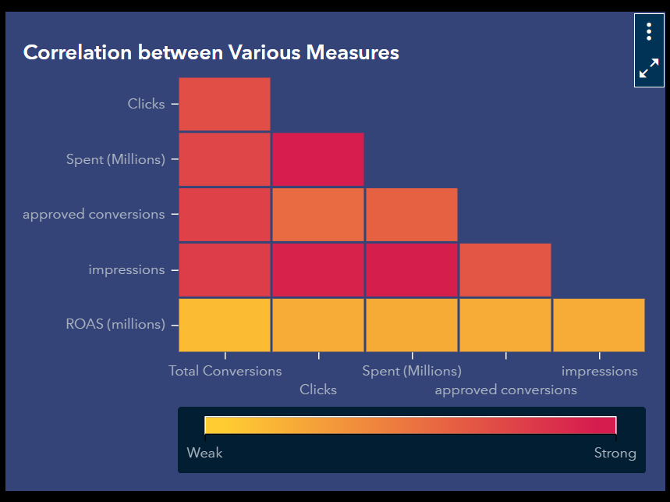
Results and Analysis
Correlations:
"Total Conversion" are more correlated with "Approved Conversion" than "Clicks" and "Spent“ while "Impressions" are more correlated with "Clicks" and "Spent“ than "Approved Conversion" .
Figure 10 correlation matrix

Slide 18
2) Campaign India:
Campaign India has the best return on investment out of all 3 campaigns thus proving to be more profitable.
Figure 11 geomap of costs to return

Slide 19

3) Demographic
1) In campaign USA and campaign India, campaign China the age group of 30-34 shows more interest.
2) Both the genders shows similar interests in all three campaigns.
Figure 12 interest of female and male
Figure 13 Interest by age and campaign ID

Slide 20
Business optimization:
1) How to optimize the social ad campaigns for the highest conversion rate possible. (Attain best Reach to Conversion ratios/Click to Conversion ratios)
The number of ad counts i.e. "impression", should be more for better reach.
The age group of 30-34 should be the main aim.
The more you spend and the number of times the add is shown i.e. "impression", more approved conversion rate is achieved.

Slide 21
2) Finding the perfect target demographics with the appropriate clickthrough rates:
Males tend to buy the product more often after clicking the ad than women.
Also, the age group 30 to 34 buy the product more often after clicking the ad.

Slide 22
References
// Mention books, sites, papers and other references that you have followed for the
work done until now.
//IEEE Format.
// <Author 1>, <Author 2>…..<Author n>, “Title”, Publisher name/conference proceeding title , Edition, Volume number, Issue number, Page number, month and year of publication, ISSN no., ISBN no., Web address

Slide 23
THANK YOU
// font size: 44, centre, bold

